Slide 1
System Programming
Chapter One: Introduction
Haymanot F.(MSC)
Debre markos university
School of computing
Department of Software Engineering
2013 E.C.

Slide 2
Contents
Basic terminology
System software and machine architecture
The Simplified Instructional Computer (SIC)
  SIC and SIC/XE Machine architecture
  Data and instruction formats
  Addressing modes
  Instruction sets
  I/O
  Programming Examples

Slide 3
Basic terminology
System: Group of related things that works towards common goal.
    An organized collection of parts(sub systems)are integrated together to accomplish goal
    E.g. computer( made from integrated components like I/O, cpu , storage etc.)
Program/Software: executable sw runs on a machine like computer
    Consists a compiled code that can run directly from the computer’s operating system.
Types of software: there are two types
  Application SW
  System SW

Slide 4
CON…
Application Software
  A set of programs written in a specific programming language to solve a particular problem.
  It is independent of the machine on which it is operated.
  Concerned mainly with the solution of the problem and makes use of the computer software as a tool.
  Purpose of supporting or improving the user’s work with a software (it gives services for user)
  The focus is on the application
Example:
  Word processing :MS word, WordPad
  Database :Oracle, MS Access
  Spreadsheet :Excel, Apple Numbers
  Multimedia :Real Player, Media Player
  Presentation Graphics :MS PowerPoint

Slide 5
CON…
System Software
It is software designed to provide a platform for other software.
  A set of programs that creates the environment to facilitate working of an application software.
  Able effective execution of application Software
  Acts as an intermediary between computer hardware and application programs.
  Controls the computer system and enhances its performance.
  Focus is on the system.
  Machine dependent(Instruction Set, Instruction Format, Addressing Mode)
  However , general design and logic of an assembler and compiler, code optimization techniques are machine independent
System programming means development of computer programs that allow the entire system to function as a single unit.

Slide 6
Examples of System Software
Operating systems: like macOS, Linux, Android and Microsoft Windows, computational science software, game engines, industrial automation,
Text Editor
  Allows user to create/modify a file having only plain text.
  Edit contents to get an immediate visual feedback
  Notepad (Microsoft)
Compiler
  Translates high level language to machine language.
  Source code into data, that computer can understand.
  Source code to object code
    ADA, BASIC, Fortran, Pascal
    C, C++, C#
    Open Source like java
Linker
  Gathers 1 or more objects codes generated by the compiler & combines into a single EXE
Notes:
System Software
Operating System
Text Editor
Compiler
Linker
Loader
Debugger
Assembler
Interpreter

Slide 7
CON…
Loader
  Loads object code into memory for execution
Debugger
  Tests & debugs errors
  Code run on Instruction Set Simulator (ISS)
      DEBUG – Microsoft DOS built-in debugger
      Nemiver – Graphical C/C++ debugger
      Ups – Fortran, C
      VB Watch – Visual Basic
      Jswat – Open source Java
      Xdebug – PHP
Assembler
  Assembly language to machine language
  Mnemonics to machine code , Produces executable machine code
Interpreter
  High level language to machine language

Slide 8
Need for System Software
Controls some of the aspects of operation of computers.
  File operation
  I/O operation
  Memory management
  Etc.
Notes:
What is the Need of System Software ?

Slide 9
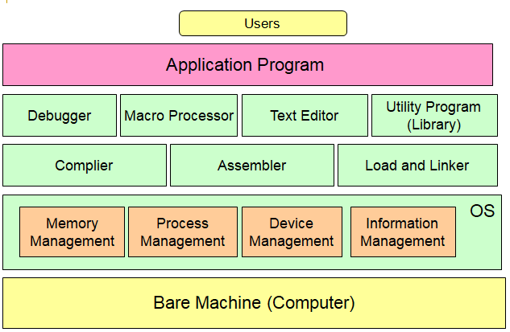
System Software concept

Slide 10
System software and machine architecture
One characteristic in which most system software differ from application software is machine dependency.
  e.g. assembler translate mnemonic instructions into machine code
  e.g. compilers must generate machine language code
  e.g. operating systems are directly concerned with the management of nearly all of the resources of a computing system
Some aspects of system software that do not directly depend upon the type of computing system
  e.g. general design and logic of an assembler and compiler
  e.g. code optimization techniques

Slide 11
The Simplified Instructional Computer (SIC)
SIC is a hypothetical computer system introduced in System Software.
  It includes the hardware features most often found on real machines while avoiding unusual or irrelevant complexities
  Since it is difficult to learn system programming on real computer system SIC introduced.
Two versions of SIC
  SIC - standard model
  SIC/XE (extra equipments or extra expensive)
    SIC program can be executed on SIC/XE (upward compatible)
The two versions has been designed to be upward compatible.
      Object program for the standard SIC machine will execute properly on SIC/XE system.
Notes:
Watch This =>

Slide 12
  SIC Machine Architecture
Memory
  Memory consists of 8-bit , 3 consecutive bytes form a word (24 bits), SIC is designed as a 24-bit machine. Total of 32768 bytes (32 KB) in the computer memory.
  A word is addressed by is lowest numbered byte (i.e., addressing starts at byte 0).
Register: SIC machines have 5 registers
Register | Number | Known as | Use
A | 0 | Accumulator | Arithmetic operations
X | 1 | Index register | Addressing
L | 2 | Linkage register | jumping to specific memory addresses and storing return addresses
PC | 8 | Program counter | Contains the address of the next instruction to execute
SW | 9 | Status word | Contains a variety of information, such as carry or overflow flags
Notes:
Register : is a temporary storage area built into a CPU, registers are used to pass data from memory to the processor
Flags : is a value that acts as a signal for a function or process

Slide 13
SIC Machine Architecture …
Data Formats
  Integers are stored as 24-bit binary numbers
  2’s complement for negative values
  8-bit ASCII for characters
  No floating point hardware in standard SIC
Instruction Formats
  24-bit format
  x indicates indexed addressing mode
  8 1 15
opcode | X | address

Slide 14
SIC Machine Architecture …
Addressing modes
  2 addressing modes available
    Indicated by x bit in the instruction
    (x) represents the contents of register x
Mode | Indication | Target address calculation
Direct | x = 0 | TA = address
Indexed | x = 1 | TA = address + (x)

Slide 15
SIC Machine Architecture …
Instruction Set
  load and store: To move or store data from accumulator to memory or vice-versa example : LDA, LDX, STA, STX …
  Arithmetic operations: ADD, SUB, MUL, DIV, etc.
    Used to perform operations on accumulator and memory and store result in accumulator (register A)
  comparison: COMP
    compares the value in register A with a word in memory, this instruction sets a condition code CC to indicate the result
  conditional jump instructions: JLT, JEQ, JGT
    these instructions test the setting of condition code CC and jump accordingly
  subroutine linkage: JSUB, RSUB
    JSUB jumps to the subroutine, placing the return address in register L
    RSUB returns by jumping to the address contained in register L
Notes:
a subroutine is a sequence of program instructions that performs a specific task

Slide 16
SIC Machine Architecture …
Input and Output
  Input and output are performed by transferring 1 byte at a time to or from the rightmost 8 bits of register A
  The Test Device (TD): instruction tests whether the addressed device is ready to send or receive a byte of data
  “Less Than “ if device is ready; “Equal” if device is busy.
  Read Data (RD)
    read a byte from the device to register A
  Write Data (WD)
    write a byte from register A to the device
Notes:
SIC Machine Architecture
- Memory
- Register
- Data Formats
- Instruction Formats
- Instruction Set
- Addressing Modes
- Input and Output

Slide 17
Machine code instruction
Machine code is a set of instructions executed directly by a computer's central processing unit(cpu)
Each instruction performs a very specific task, such as a load, a jump, or an ALU operation on a unit of data in a CPU register or memory.
Machine code instruction usually consists operation code(op code) & operands
Some instructions consists only operation code
Op code is a mnemonic used to refer to a microprocessor instruction in assembly language
Operand is A quantity to which an operator is applied (in 3 - x, the operands of the subtraction operator are 3 and x).
All operation code and operands are binary code

Slide 18
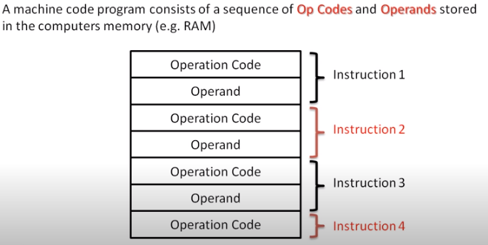
Con…

Slide 19
SIC/XE Machine Architecture
Memory
  Larger Memory
    2²⁰ bytes (1 megabyte) in the computer memory
    Leads to change in instruction formats & addressing modes
Registers
  Additional registers provided
Mnemonic | Number | Use
B | 3 | Base register – used for addressing
S | 4 | General purpose register – no special use
T | 5 | General purpose register – no special use
F | 6 | Floating point accumulator (48 bits instead 24 bits)
Notes:
SIC/XE Machine Architecture
- Memory
- Registers
- Data Format
- Instruction Format
- Addressing Modes
- Instruction Set
- Input/Output

Slide 20
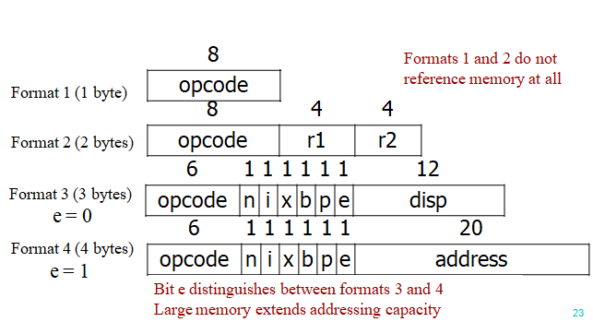
SIC/XE Machine Architecture…
Data format
  24-bit binary number for integer, 2’s complement for negative values
  48-bit floating-point data type
  The exponent is between 0 and 2047
  value represented = f*2(exponent-1024) , f is fraction b/n 0 &1
Instruction format

Slide 21
SIC/XE Machine Architecture…
Format 1: Consists of 8 bits of allocated memory to store instructions. Don't refer memory location
Format 2: Consists of 16 bits of allocated memory to store 8 bits of instructions and two 4-bits segments to store operands(source and destination register)
Format 3: Consists of 6 bits to store an instruction, 6 bits of flag values, and 12 bits of displacement.
Format 4: Only valid on SIC/XE machines, consists of the same elements as format 3, but instead of a 12-bit displacement, stores a 20-bit address.
Both format 3 and format 4 have six-bit flag values in them, consisting of the following flag bits:
  n: Indirect addressing flag
  i: Immediate addressing flag
  x: Indexed addressing flag
  b: Base address-relative flag
  p: Program counter-relative flag
  e: Extended for Format 4 instruction flag

Slide 22
SIC/XE Machine Architecture…
Addressing modes
  Base relative (n=1, i=1, b=1, p=0)
  Program-counter relative (n=1, i=1, b=0, p=1)
  Direct (n=1, i=1, b=0, p=0)
  Immediate (n=0, i=1, x=0)
  Indirect (n=1, i=0, x=0)
  Indexing (both n & i = 0(SIC) or 1(SIC/EX), x=1)
  Extended (e=1) for format 4 and e=0 for format 3
    Note: Indexing cannot be used with immediate or indirect addressing.

Slide 23
SIC/XE Machine…
Base Relative Addressing Mode
 | n | i | x | b | p | e
opcode | 1 | 1 |  | 1 | 0 |  | disp
n=1, i=1, b=1, p=0 TA=(B)+disp (0≤disp ≤4095)
Program-Counter Relative Addressing Mode
 | n | i | x | b | p | e
opcode | 1 | 1 |  | 0 | 1 |  | disp
n=1, i=1, b=0, p=1 TA=(PC)+disp (-2048≤disp ≤2047)

Slide 24
SIC/XE Machine…
Direct Addressing Mode
 | n | i | x | b | p | e
opcode | 1 | 1 |  | 0 | 0 |  | disp
n=1, i=1, b=0, p=0 TA=disp (0≤disp ≤4095)
 | n | i | x | b | p | e
opcode | 1 | 1 | 1 | 0 | 0 |  | disp
n=1, i=1, b=0, p=0 TA=(X)+disp
(with index addressing mode)

Slide 25
SIC/XE Machine…
Immediate Addressing Mode
 | n | i | x | b | p | e
opcode | 0 | 1 | 0 |  |  |  | disp
n=0, i=1, x=0 TA = disp
Indirect Addressing Mode
 | n | i | x | b | p | e
opcode | 1 | 0 | 0 |  |  |  | disp
n=1, i=0, x=0 TA=(disp)

Slide 26
Con..
PC-relative simple addressing: (PC) + disp
Base-relative indexed simple addressing: (B) + disp + (X)
PC-relative indirect addressing: (PC) + disp
Immediate addressing: disp
Indirect addressing :disp

Slide 27
SIC/XE machine architecture…
Instruction Set
  new registers: LDB, STB, etc.
  floating-point arithmetic: ADDF, SUBF, MULF, DIVF
  register move: RMO
  register-register arithmetic: ADDR, SUBR, MULR, DIVR
  supervisor call: SVC
    generates an interrupt for OS
Input/output
  SIO, TIO, HIO: start, test, halt the operation of I/O device

Slide 28
SIC Assembly Syntax
SIC uses a special assembly language with its own operation codes that hold the hex values needed to assemble and execute programs.
A sample program is provided below to get an idea of what a SIC program might look like.
The first column represents a forwarded symbol that will store its location in memory.
The second column denotes either a SIC instruction (opcode) or a constant value (BYTE or WORD).
The third column takes the symbol value obtained by going through the first column and uses it to run the operation specified in the second column.
This process creates an object code, and all the object codes are put into an object file to be run by the SIC machine.

Slide 29
SIC and SIC/XE Programming Examples
Data movement operations
Arithmetic operations
Looping and indexing operations
Data input and output operations
Notes:
What are The Examples Of SIC and SIC/XE ?

Slide 30
Programming Examples
WORD – Integer constant
BYTE – Character constant
RESW - Reserve indicated
number of words for a data area
RESB - Reserve indicated
number of bytes for a data area
30

Slide 31
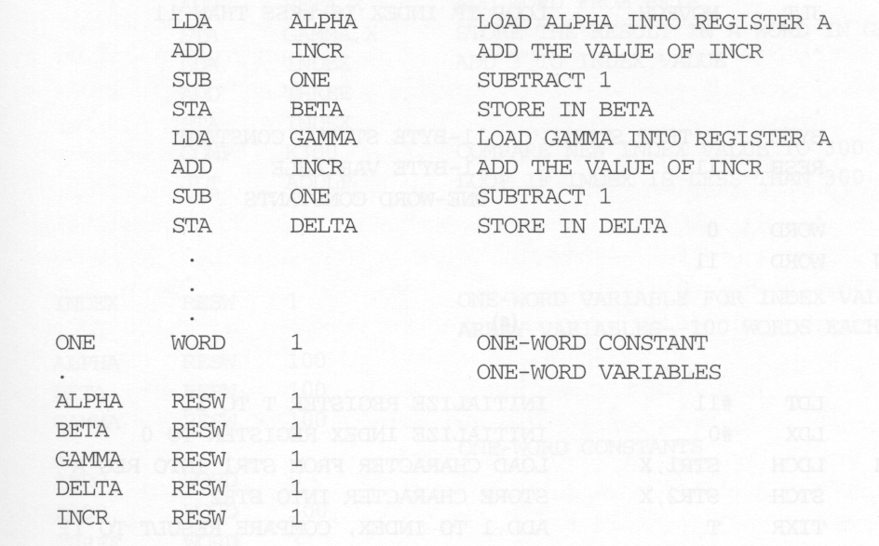
Programming Examples
BETA (ALPHA + INCR - 1)
DELTA (GAMMA + INCR - 1)
Fig: Arithmetic operations SIC

Slide 32
SIC Programming Example loop
LDA ZERO initialize index value to 0
STA INDEX
ADDLP LDX INDEX load index value to reg X
LDA ALPHA,X load word from ALPHA into reg A
ADD BETA,X
STA GAMMA,X store the result in a word in GAMMA
LDA INDEX
ADD THREE add 3 to index value
STA INDEX
COMP K300 compare new index value to 300
JLT ADDLP loop if less than 300
...
...
INDEX RESW 1
ALPHA RESW 100 array variables—100 words each
BETA RESW 100
GAMMA RESW 100
ZERO WORD 0 one-word constants
THREE WORD 3
K300 WORD 300
Gamma[] = Alpha[] + Beta[]

Slide 33
SIC Programming Example I/O
Input and output
INLOOP TD INDEV test input device
JEQ INLOOP loop until device is ready
RD INDEV read one byte into register A
STCH DATA
.
.
OUTLP TD OUTDEV test output device
JEQ OUTLP loop until device is ready
LDCH DATA
WD OUTDEV write one byte to output device
.
.
INDEV BYTE X’F1’ input device number
OUTDEV BYTE X’05’ output device number
DATA RESB 1

Slide 34
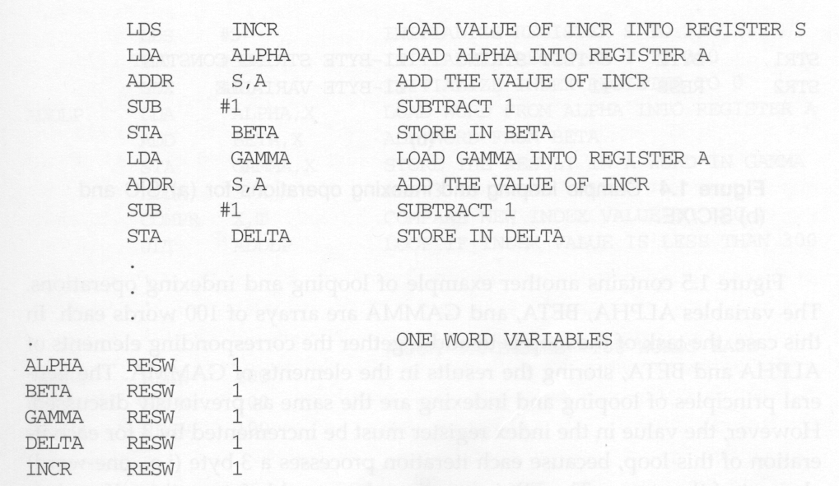
SIC/ex Programming Examples
Arithmetic operation.
BETA (ALPHA + INCR - 1)
DELTA (GAMMA + INCR - 1)
This program will execute faster because
it need not load INCR from memory
each time when INCR is needed.

Slide 35
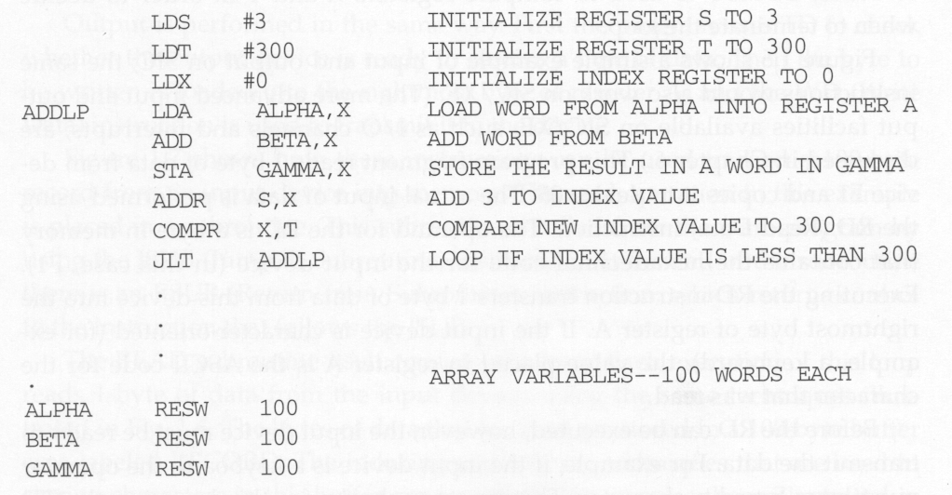
SIC/EX Programming Examples
Looping and indexing
This program will execute faster
because it uses register-to-register
add to reduce memory accesses.
Fig: Looping & indexing SIC/XE

Slide 36
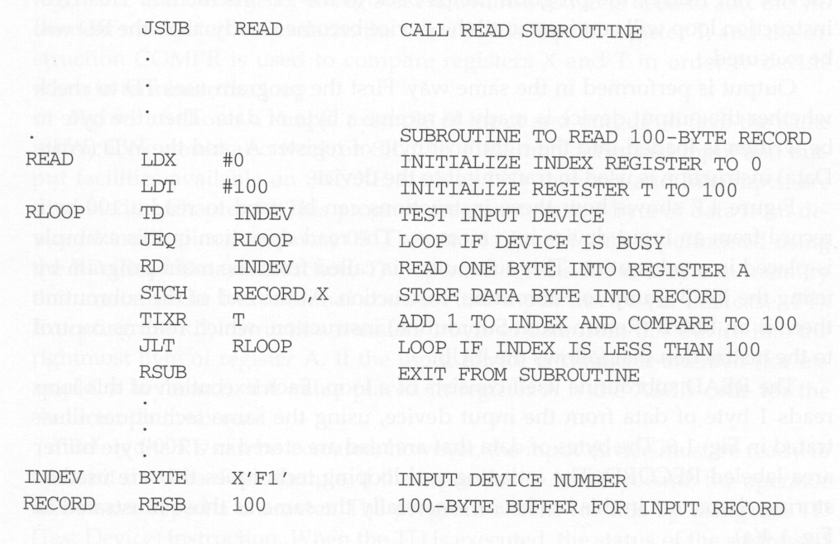
SIC/EX Programming Examples
Input /output
Fig: Subroutine call & record input operations SIC/XE

Slide 37
Thank you!
Question?

